Slide 1
CSE 420 Lecture 19
Runtime Engine: Stack

Slide 2
Background Review

Slide 3
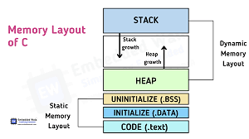
Memory Layout of a Process
You learned about the memory layout of a process in the operating system course.
You also learned then that this layout is the layout of the logical address space of the process.
Actually, it is the compiler that is responsible for generating this layout.
By this, we understand that the compiler generates the executable machine code in a manner so that our known address space is maintained.
Static Data
Image Source: https://embeddedwala.com/Blogs/embedded-c/memory-layout-of-c-program

Slide 4
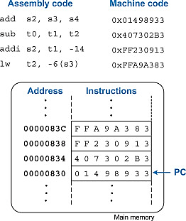
Content of an Executable Program
When your executable program is resting on the hard disk, it only contains the architecture-specific machine code corresponding to three-address code that we learned to generate.
Apart from that some meta-data information retains information about static data sections and some other information.
When a process is created by the operating system for your program and the process is allowed to execute in the CPU/CPU-cores then the variables of your program gets their values and their space in the logical address space.
Hence it is the compiler that decides where what variable should be allocated and how and generates the machine instructions accordingly so that values of variables can be read/write.
Image Source: https://www.sciencedirect.com/topics/engineering/machine-code

Slide 5
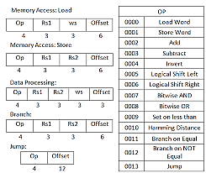
Addresses Not Variables
Remember that there is no concepts of variables in machine instructions in any ISA architecture.
Furthermore, direct arithmetic/logic operations on values stored in RAM addresses are also impossible.
Rather the way a process makes progress can be described as the following:
Store results of operations in RAM addresses from CPU registers using other instructions.
Load machine instruction from RAM addresses.
Load necessary data from appropriate RAM addresses to CPU registers.
Interpret instructions to decide what to do and on what data.
Do arithmetic/logic operations on data loaded on CPU registers using some instructions.
Image Sources: https://www.researchgate.net/figure/nstruction-Format-of-RISC-This-section-includes-three-Instruction-Formats_fig1_345445820

Slide 6
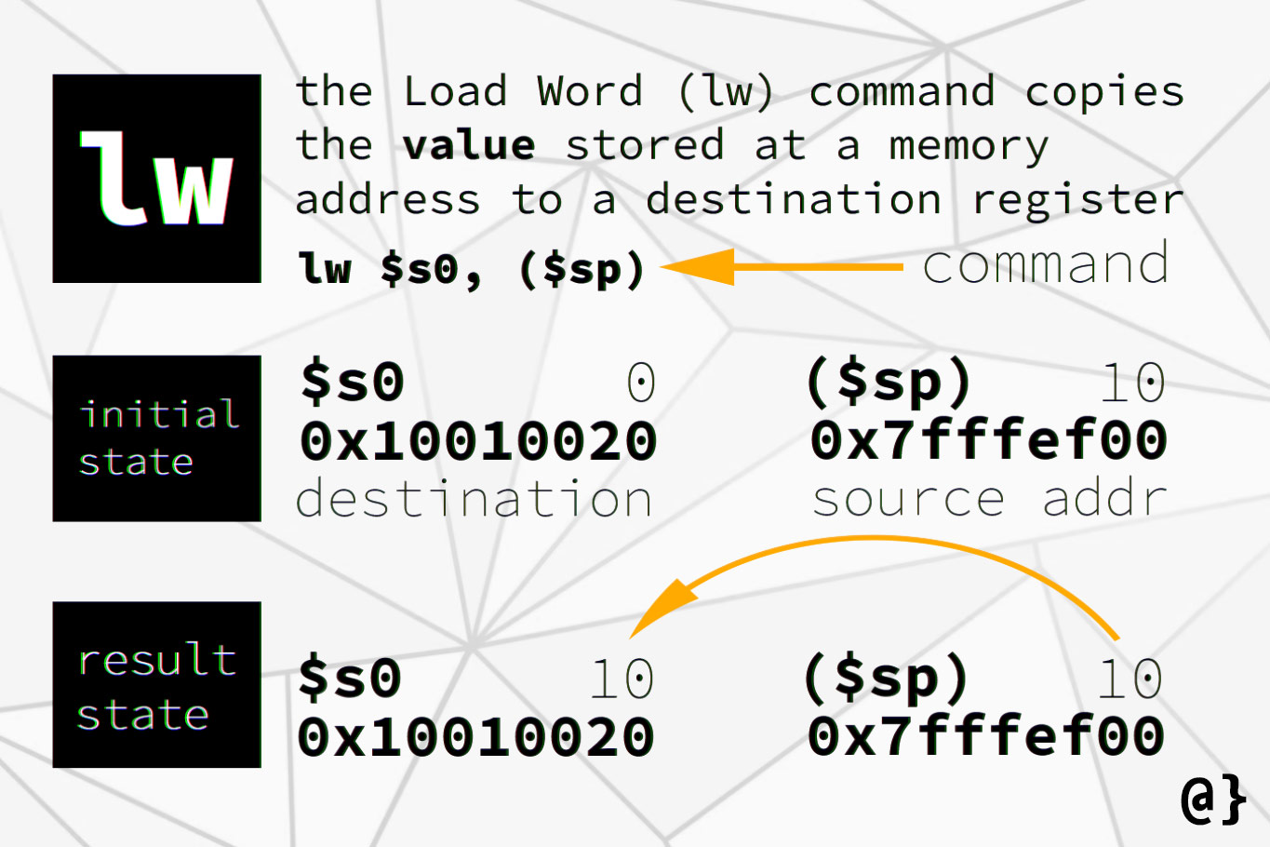
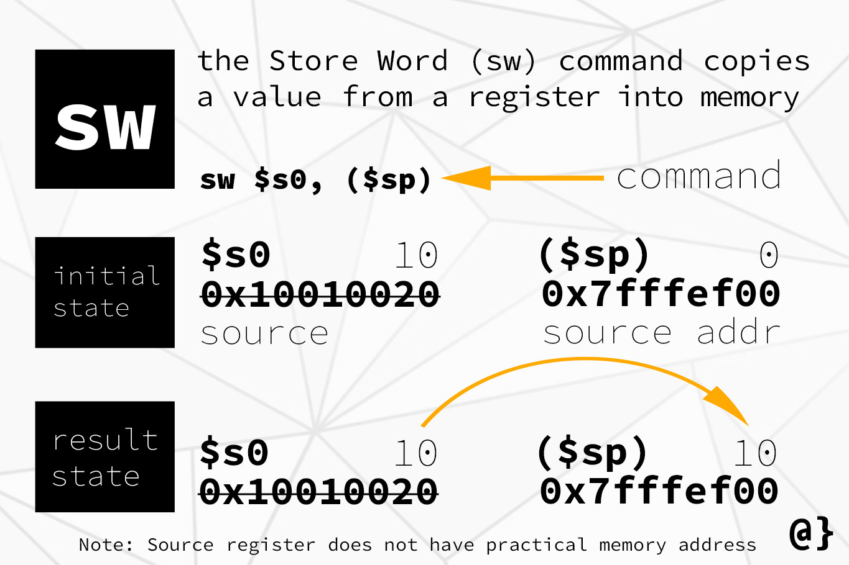
Loading Storing Variables to/from CPU
During the code generation phase, compiler translates the variables and temporaries of the three-address code into logical addresses in the RAM.
All access to the variables and temporaries are then translated into accessing specific RAM addresses.
The compiler, uses the symbol tables of underlying scope to decide which address should be used for what variable.
Then some variant of load and store instructions are used to move data to/from RAM and CPU for arithmetic and logic operations.
Image Sources: https://www.alpharithms.com/mips-store-word-sw-vs-load-word-lw-475521/

Slide 7
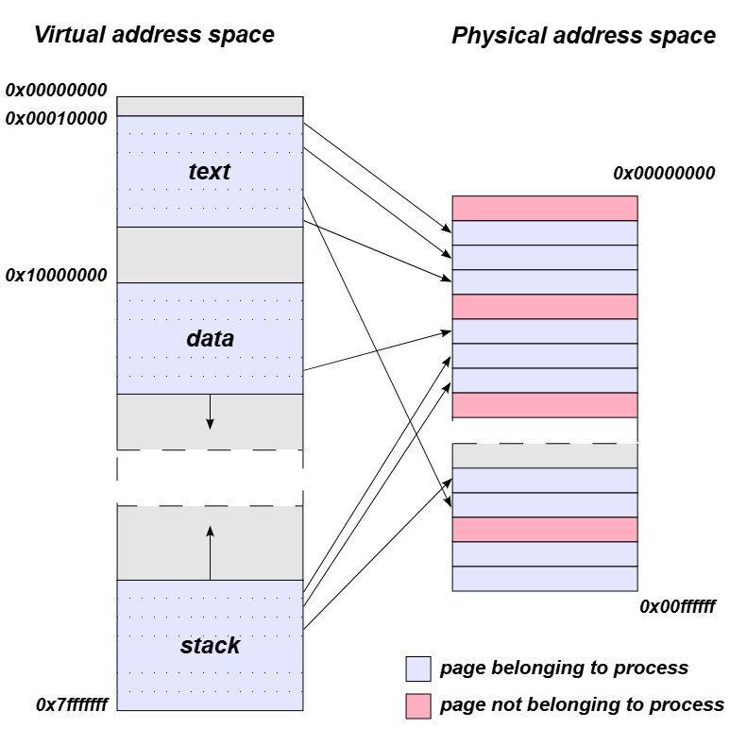
Logical and Physical Address Spaces
Remember that the addresses of instructions and data used in the machine code are logical addresses.
In reality, operating system divides the logical address space into equal size chunks, called pages, and give different physical chunks, called frames, in the RAM to this different chunks.
This process is called logical-to-physical address mapping and the process in execution knows nothing about this difference.
Image Sources: https://en.wikipedia.org/wiki/Page_table

Slide 8
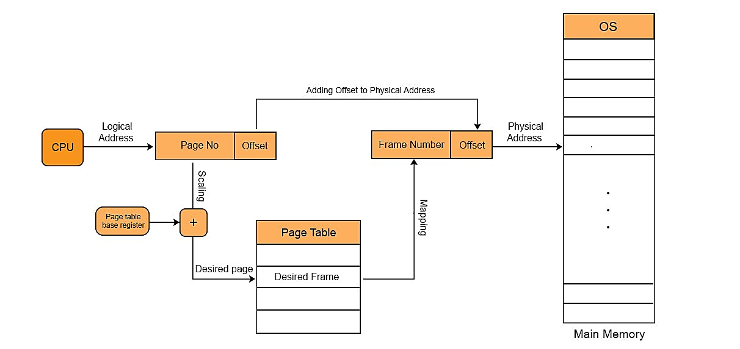
Compiler and Operating System Role Breakdown
During the process execution, CPU hardware automatically translate logical addresses of instructions and data to proper physical addresses.
The operating system is only responsible for allocating frames for pages and loading some metadata in specific CPU registers so that the translation can be done by the CPU.
So as long as the compiler generates instructions that refer to proper logical addresses, everything should be alright.
Image Sources: https://cstaleem.com/page-table-and-mapping

Slide 9
Memory Layout and Machine Code Interplay

Slide 10
Assigning Addresses to Variables
For global and fixed length variables, address deciding is easy.
The compiler fixes specific locations in the static data section for variables.
Symbol table information is used to determine how much space each variable is needed and in what order to assign them address to avoid space overlapping.
Subsequently, three address instructions referring to the variables are replaced by access of those addresses.
Deciding the addresses of function parameters and local variables is much more complicated, for which we need the stack.

Slide 11
Example of Global Variable Address Assignment
Source code:
int x = 10;
float y;
void main() {
y = x * 2.5 + 1.6;
}
8 bytes
Static Data
Address for y
Address for x
4 bytes
Assembly Code:
lw $s1, $s0[0]
multi $t0, $s1, 2.5
Addi $t1, $t0, 1.6
sdw $t1, $s0[4]
Machine Instructions
Text
Layout of the logical Address Space
Assume the address where text section end is stored in register $s0
Three Address code:
t0 = x * 2.5
t1 = t0 + 1.6
y = t1
Here $.. Means some CPU Register.

Slide 12
Challenges with Function Local Variables
Static address allocation of variables does not work for variables that are local to functions.
This fact can be understood from nested function calls.
However, recursive functions illustrates this concepts very well.
void main() {
int x = 5;
int y = foo(x);
y = y / x;
}
int foo(int a) {
int b = a * a;
int c = a + a;
if (c < b / 2) {
return b + c + foo(a - 1);
} else {
return b - c;
}
}
Assumed static addresses for local variable b and c of function foo
b = 25 then 16
c = 10 then 8
Main
x = 5
foo(4)
b = 25
c = 10
foo(9)
b = 16
c = 8
The problem if the call from foo(5) to foo(4) will override b and c from 25 and 10 to 16 and 8 if the address is static. So we cannot go back to foo(5) and return 25 + 10 + 8 to main.
Consider this sample recursive code

Slide 13
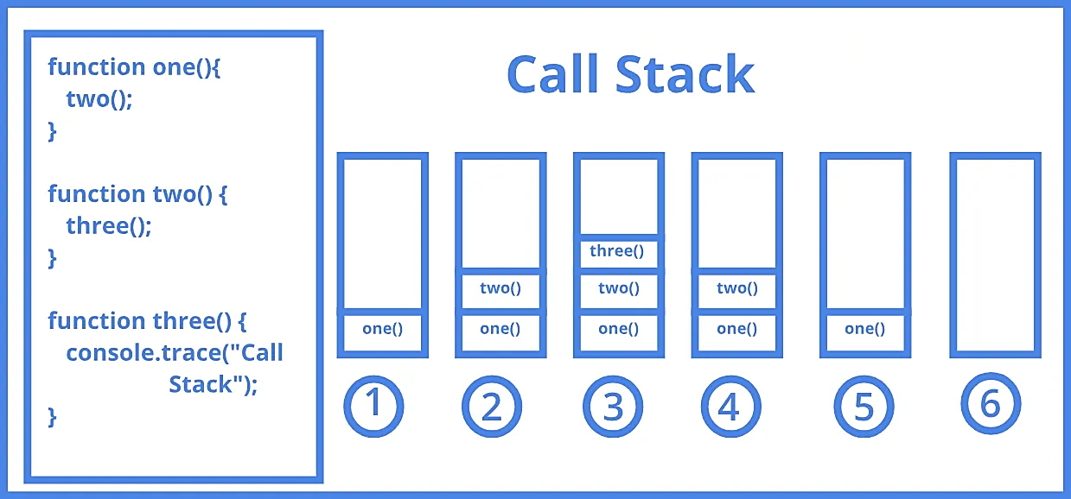
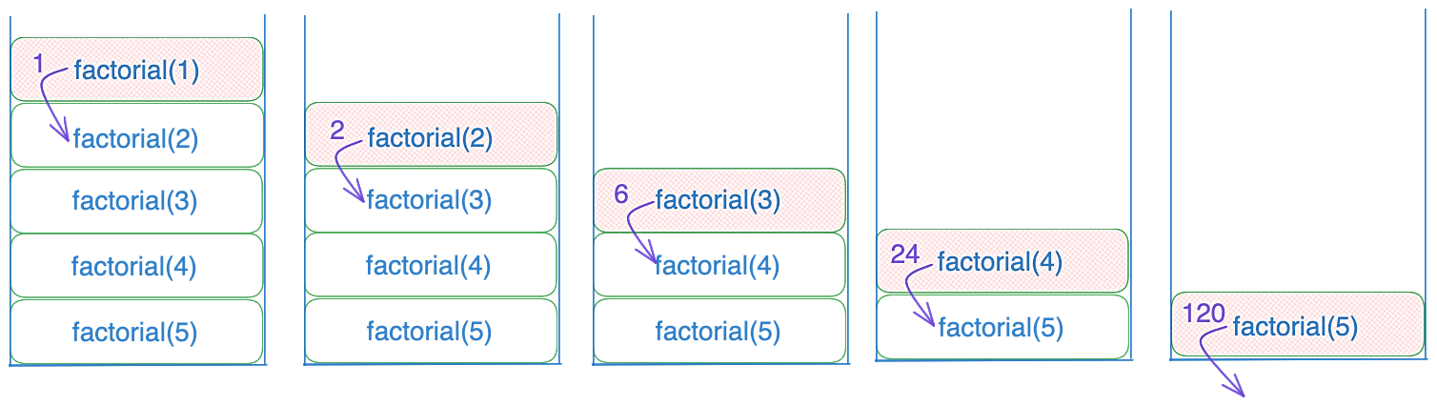
The Idea of Function Call Stack
The lesson we learn from the previous example is that each time a function call happens, we must find new space in the logical address space of the process to allocate its local variables.
This gives rise to the concepts of stacks.
All necessary information related to function calls: including function parameters, location for return values, function’s local variables, and instruction of the caller to return to when a function completes executions is stored in a stack. This information is called function activation record.
As function calls other functions, stack grows.
As the last called function returns, its space in the stack is freed and the code returns to the previous function using information stored in the stack.
Function activation records for nested function calls.
Function activation records for recursive function calls.
Image sources: https://launchschool.com/books/advanced_dsa/read/exploring_call_stack
https://www.linkedin.com/pulse/javascript-call-stack-shivesh-rajput-s9rnc

Slide 14
Stack Relative Variable Addressing
A specific register in the CPU, called the stack pointer (denoted by $sp) refers to the beginning of a function’s local address space (where it stores local variables and temporaries). The local variables of the functions are accessed relative to that stack pointer.
This allows difference instances of the same function to use different addresses for the same local variables.
A possible assembly code
Source Code
k = foo(3, 6)
foo(int a, int b) {
int x = a * b;
return x;
}
swi $sp, 3 # store a
addi $sp, $sp, -4 # advance $sp
swi $sp, 6 # store b
addi $sp, $sp, -4 # advance $sp
addi $sp, $sp, -4 # space for return value
jal FOO-Addr # do the function call
Code at FOO-Addr
lw $s0, $sp[12] # load a
lw $s1, $sp[8] # load b
mult $s2, $s0, $s1 # x = a * b
sw $s2, $sp[4] # store result above stack
jr $ra # return to caller instruction
Current address stored in $sp
a
b
Space for return value
Three address code
param 3
param 6
k = call FOO, 2
FOO:
x = a * b
return x
x
General idea of stack use

Slide 15
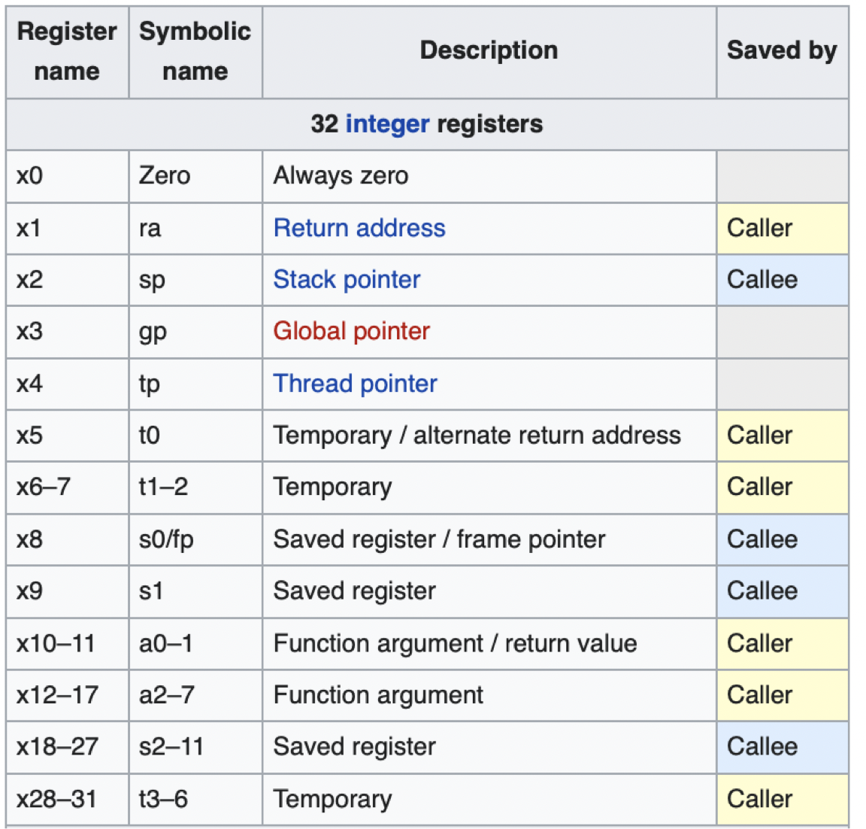
Stack Space Allocation Despite Having Parameter and Return Value Registers
Most instruction set architectures have a few parameter and return value registers to pass arguments and return values between function calls.
However, the common practice is still storing them in stack because these registers only allow limited information passing.
A user defined function may have many parameters of different types that may not fit in just one or two registers.
Similarly, the return value may be so large that it may not fit in a register.
Consequently, reserving stack space is the only general options.
Compilers use these registers when they can be used for specific functions as an optimization of the general function call handling convention.
Image Sources: https://stackoverflow.com/questions/74094483/why-temporary-registers-and-saved-registers-in-risc-v-are-not-numbered-sequentia

Slide 16
Advantage of Stack In Particular
Note that for function call management, any strategy that allocates separate non-overlapping regions from the logical address space for each function should work.
However, there is a great advantage in stack and stack relative addressing in particular.
Function call sequence has the nature of last-in-first out progression. Where, the last function being called is the one whose memory should be reclaimed first.
Afterwards, the immediately previous function that called it become active and candidate for the next cleanup.
Hence, the behavior of function call chain is just like the behavior of a stack.
The memory used by a function that flow of control returns from is reclaimed by simply decreasing the stack pointer register to proper value.
main
main
main
foo
foo
$sp
foo
bar
$sp
Flow returns from bar to foo
bar-2
$sp
bar is called from foo
foo calls another function bar-2
So in reality, the memory is reclaimed and re-allocated for the new function, it reuse and override the values of old function. There is no actual cleanup in-between.

Slide 17
Simplified Stack Management

Slide 18
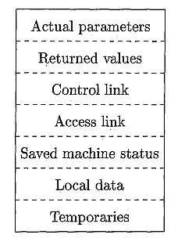
Stack Activation Frame Layout
Compilers follow a uniform layout for storing function call information in stack for all functions.
The uniformity makes code generation easier.
However, across programming languages the layout can differ.
Points to the activation record of the caller so that upon return from the current function, the stack pointer and other information can be restored to reflect the previous function.
Address of the instruction of the caller to return to and some CPU registers’ value to be restored before returning.
Used for handling variable length local data or parameters.
(Out of scope of current discussion)
Layout of a function activation record for C like languages.
Image Sources: The reference text book

Slide 19
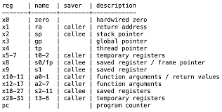
Saved Machine State Detail
Remember that CPU operations only happen on data stored in CPU registers – not on data stored in RAM addresses.
This is because accessing RAM is quite slow compared to registers inside the CPU. Furthermore, RAM is a separate chip that cannot participate in CPU data-path during arithmetic/logic operations.
Consequently, compilers try to keep results of operations and value loaded from RAM in registers as much as possible and do load/store with RAM infrequently.
In case of function calls, thus there is a convention for saving the contents of some of the register’s previous values in stack before a called function can use those registers.
This set of registers that a callee function restores to old value forms the saved machine state.
Whatever callee saves here is part of saved machine state in RISC-V5
Image Sources: https://pdos.csail.mit.edu/6.828/2024/lec/l-riscv-cc-slides.pdf

Slide 20
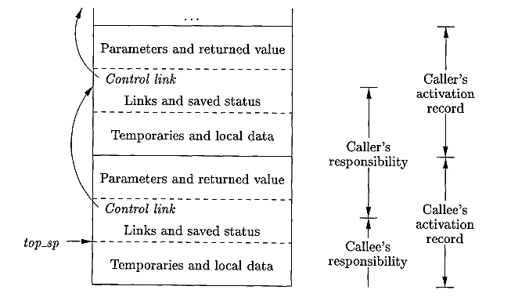
Caller and Callee Responsibility Breakdown
When compiler generates code for functions, it has to decide how to distribute the task of populating different parts of a function activation records between the caller function and the callee function.
Having the code in the callee allows the compiler to generate the code for a part only once to be used by many caller function’s code.
However, things that the callee should not know beforehand must be populated by the caller.
Image Sources: The reference text book

Slide 21
In Illustration of What Actually Happens (caller’s side)
addi $s0, 10
sw $s0, $sp[-4]
swi 5, $sp[-8]
sw $pc, $sp[-16]
sw $sp, $sp[-20]
addi $sp, $sp, -24
Jal power_addr
lw $s1, $sp[-12]
sub $s0, $s1, $s0
Set the value of x to 10
void main() {
int x = 10;
int y = power(x, 5);
x = y - x
}
int power(int a, int b) {
int power = 1;
for (int i = 0; i < b; i++) {
power = power * a;
}
return power;
}
Put parameters in stack
Put control link in stack after reserving a spot for return value
Put main’s stack pointer’s address in stack
Advance the stack pointers to the beginning of power’s activation record
Jump to the address in the text section where power function is located
Retrieve the return value, 10⁵ from stack and store it in the register for y
Sample Source Code
Do x = y -x
Main function’s code assuming $s0 register storing the value of x and $s1 the value of y.

Slide 22
In Illustration of What Actually Happens (callee’s side)
sw $s0, $sp[0]
…
sw $s11, $sp[-44]
addi $sp, $sp, -48
lw $s0, $sp[64]
ls $s1, $sp[60]
addi, $s2, $zero, 1
add $s3, $zero, $zero
loop_addr:
bge $s3, $s1, loop_end
mult $s2, $s2, $s0
addi $s3, $s3, 1
jump loop_addr
Loop_end:
sw $s2, $sp[56]
lw $s0, $sp[44]
…
lw $s11, $sp[4]
lw $ra, $sp[52]
lw $sp, $sp[48]
jr $ra
Actual code of the callee, other things are just function call overhead.
Save machine status registers’ values in stack
void main() {
int x = 10;
int y = power(x, 5);
x = y - x
}
int power(int a, int b) {
int power = 1;
for (int i = 0; i < b; i++) {
power = power * a;
}
return power;
}
Advance the stack pointer
Retrieve a and b from stack into $s0 and $s1 registers
Utilize $s2 for power variable instead of any RAM address, similarly
$s3 for the index i.
Looping code that compute a^{b}
Store the result in space in stack designated by the caller
Sample Source Code
Restore the machine state registers to their old values
Note, some of my index calculation may be wrong, but I hope you get the general idea.
Retrieve the return address $pc to jump back to
Restore the stack pointer to the value assumed by the main function
Go back to the specific line of the main just after the function call

Slide 23
Parting Message
Function call is costly.
Thus, it is better not to create functions for small chunks of code.
However, modern compilers do machine dependent and independent optimizations to collapse function calls into equivalent code inside the caller function to avoid function call overheads.
This is called inlining functions.
Furthermore, instead of loading and storing local variables in stack, compilers, try to use the machine status registers as much as possible for local variables to avoid memory access instructions.

